Slide 1
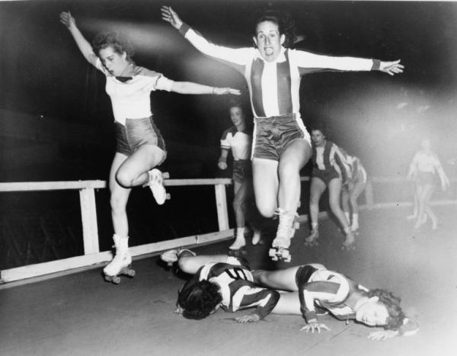
The Wonderful World of
Roller Derby
Rachel Hilton

Slide 2
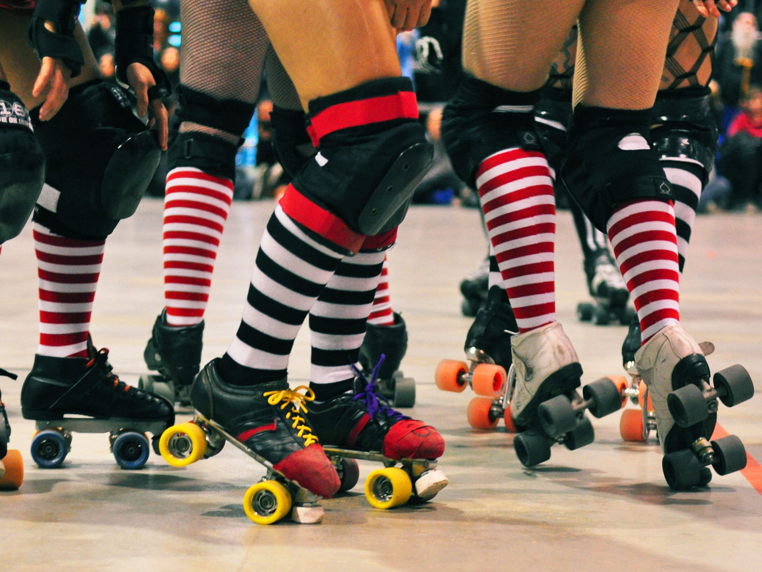
Outline
A brief History
How the Game is Played
The Perks of being a Derby Girl

Slide 3
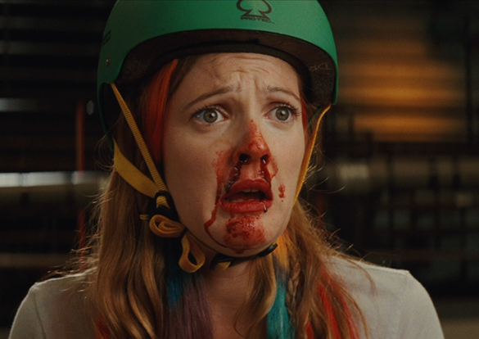
Brief History
The Beginning
  Chicago’s Transcontinental Roller Derby Race of 1935
  1937-Endurance Race turns Contact Sport
  Roller Derby gains popularity
The Revival
  2001-Austin, Texas league sparks interest
  Roller Derby Leagues Worldwide

Slide 4
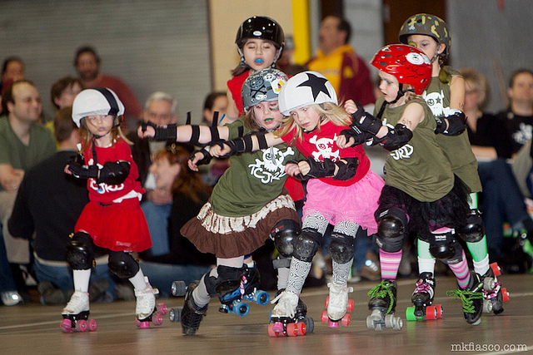
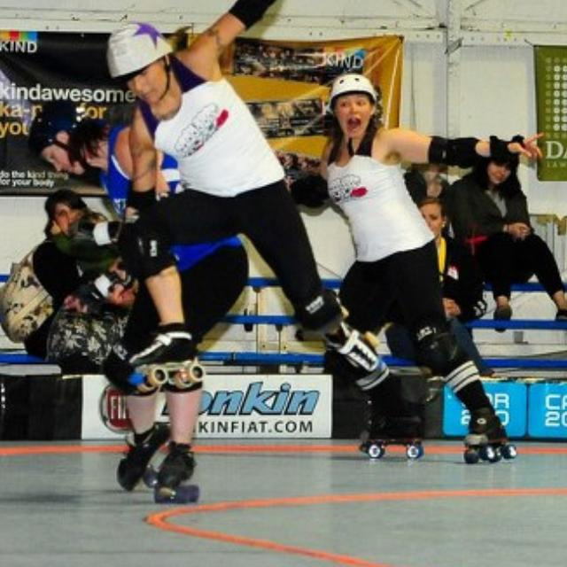
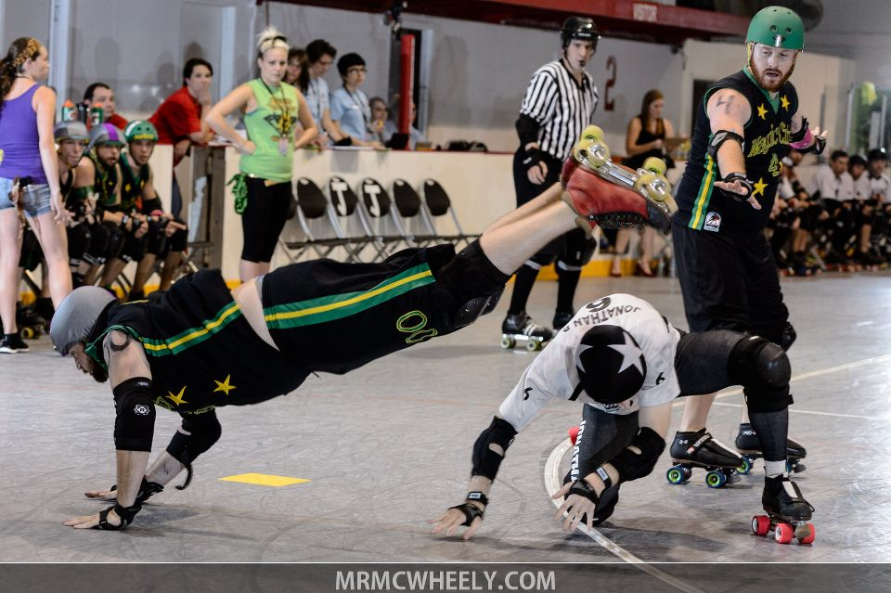
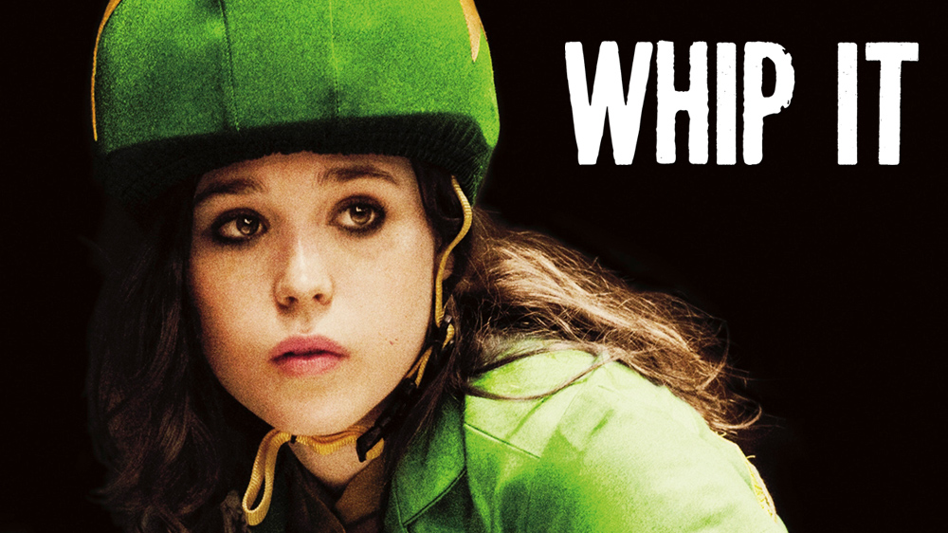
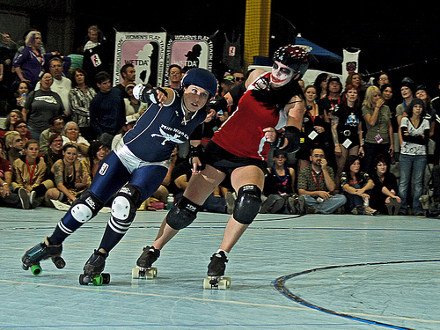
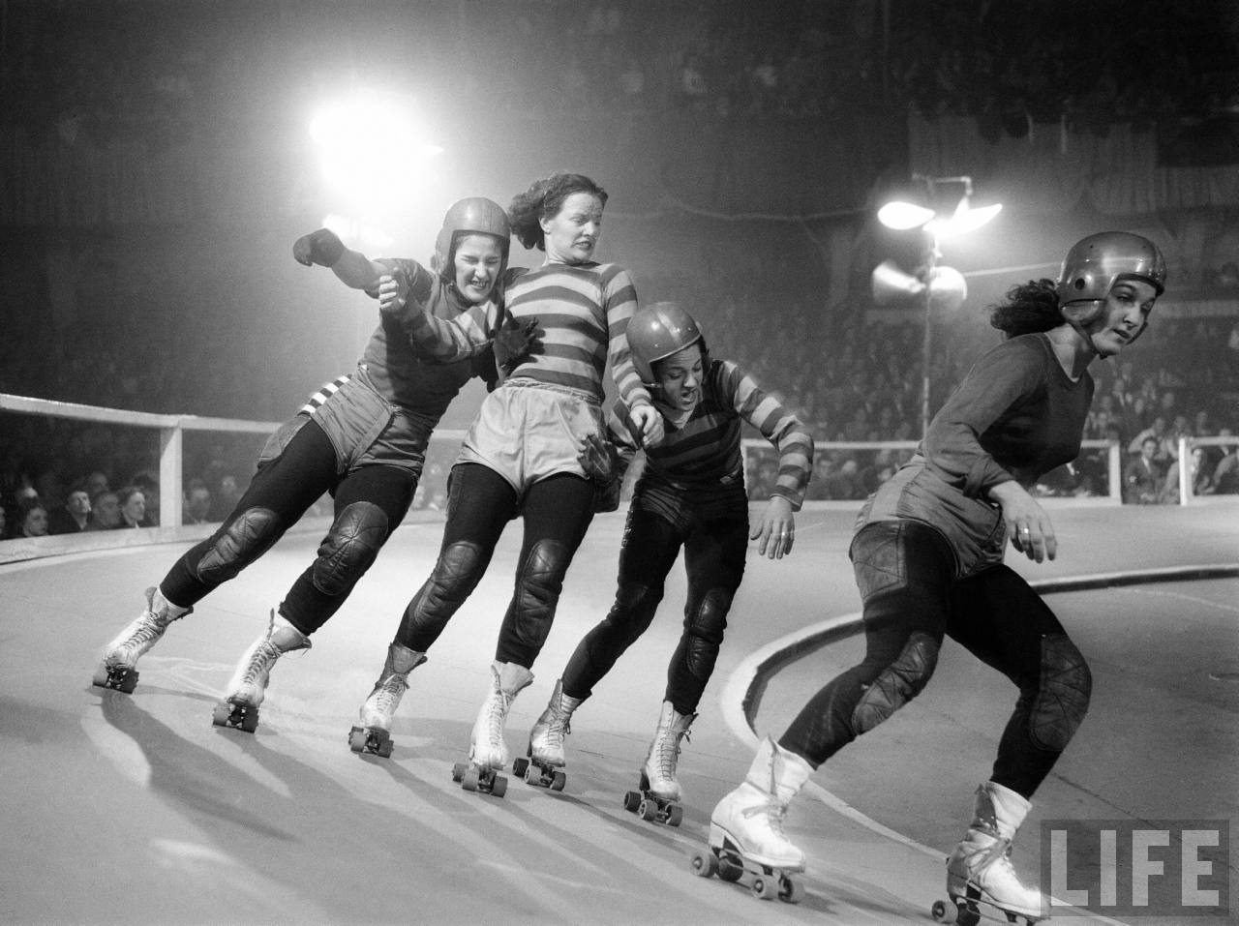
Roller Derby Today
Notes:
jfhdhkgfdgjgldcgj

Slide 5
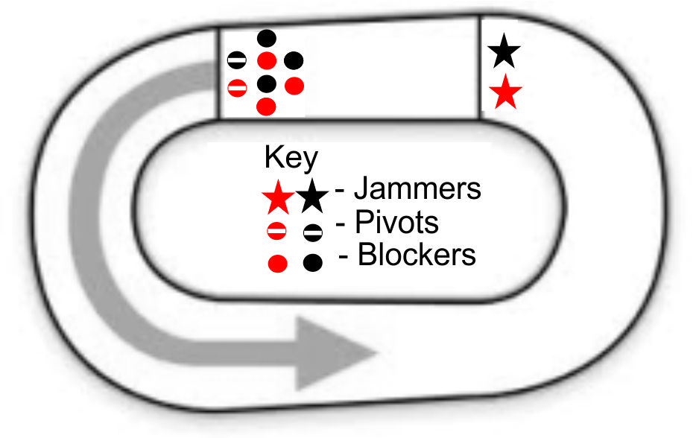
How the Game is Played

Slide 6
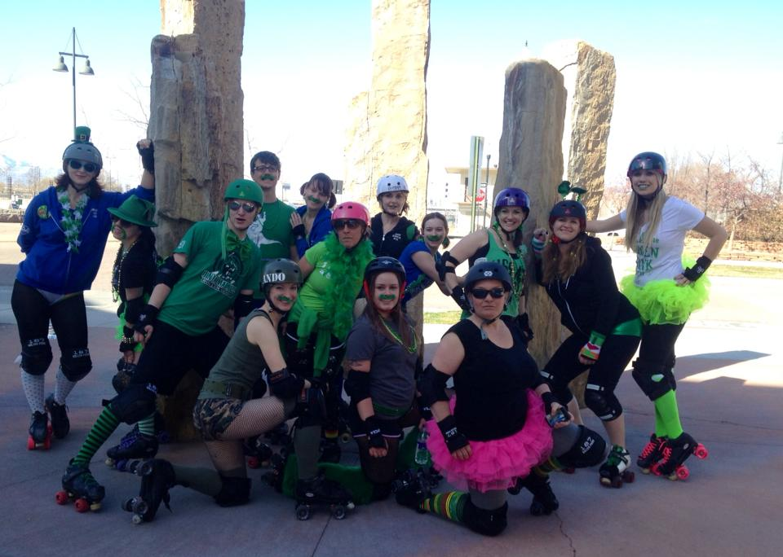

Derby Girl Perks
Decks Her Morgan | Arachna Phoebe | Bo Bituary | Meg A. Death
Fraulatio | Scarlett O Hair-pulla | Carrie Ann Conceal | Miss D. Meaner
Colonel Angus | Apostrofiend | Chick Jagger | Necrollmancer
Harry Slaughter | pHDiva | Helena Handbasket | Black n Deck Her
Taysta Pain | Atomic Bombino | Marth Vader | Maiden Mexico
Jane Error | Atticus Lynch | Maryland MonRage | Grand Slam Break Fast
Helen Kill’r | Audrey Headburn | Smashley Simpson | Ringo Scar
Slay’r | Auntie Christ | Mask A. Raid | Blackout Barbie
Scissorella | Axe S. D’nied | May Q. Hurt | Punch Face Mama
Skatey Gaga | B’kini Whacks | Meat Cleavage | Avril LaMean

Slide 7
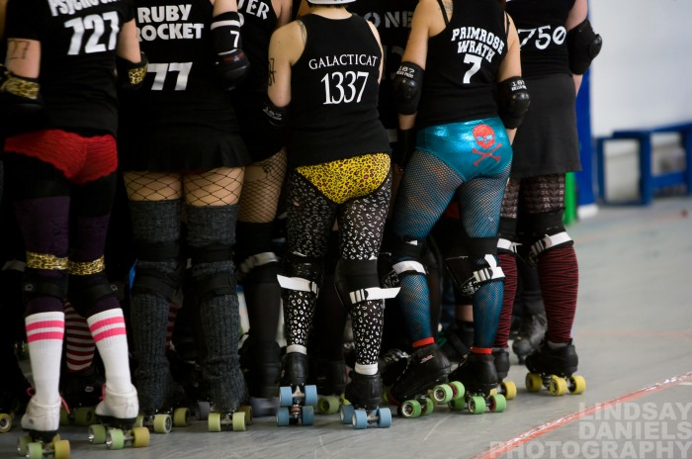
Conclusion

